Slide 1

Department of Computer Science, IT & Animation
Deogiri College, Chhatrapati Sambhajinagar-431005.
A PROJECT REPORT
On
From Beats to Bytes: Visualizing Global Music Trends with Spotify Data
Guided by
Ms. Pallavi G. Chaudhary
Submitted by
Mr. Tupe Viraj Trimbak (Roll No-121)
Mr. Udhan Amar Bhanudas (Roll No-124)
Mr. Unge Rushikesh Babasaheb (Roll No-125)

Slide 2
ACKNOWLEDGEMENT
Many people have contributed in some or the other forms to this Project, although our name appears on the cover of this Project. We could not have done this Case Study without the assistance or support of each of the following. We thank all of you. We wish to place on record our deep sense of gratitude towards our guide Ms. Pallavi G. Chaudhary and Incharge Dr. Rajashri A. Joshi for the constant motivation and valuable help through the project. We also want to express our gratitude towards our Head of the department Dr. R. A. Magre, for his invaluable guidance, insightful advice and continuous encouragement. We also extend our thanks to other faculty members for their co-operation. We also thank those who have directly as well as indirectly supported us for the completion of this Project.
Mr. Tupe Viraj Trimbak (Roll No-121)
Mr. Udhan Amar Bhanudas (Roll No-124)
Mr. Unge Rushikesh Babasaheb (Roll No-125)

Slide 3

From Beats to Bytes: Visualizing Global Music Trends with Spotify Data
Submitted By:-
Mr. Tupe Viraj Trimbak (Roll No-121)
Mr. Udhan Amar Bhanudas (Roll No-124)
Mr. Unge Rushikesh Babasaheb (Roll No-125)

Slide 4
Introduction
The music industry has evolved with streaming platforms like Spotify.
Spotify tracks listener preferences, artist performances, and song trends.
Raw data alone is not insightful—Power BI helps analyze and visualize trends.
This project transforms Spotify's "Top 200 Songs" dataset into an interactive Power BI dashboard.
The goal is to uncover patterns in music trends, artist popularity, and genre preferences.

Slide 5
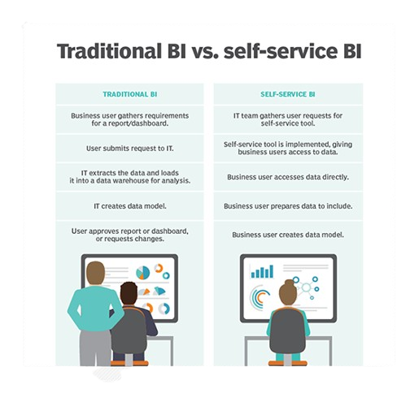
System Analysis
Current System Issues:
Manual data analysis is slow and lacks interactivity.
Large datasets require significant processing power.
Proposed System:
Use Power BI for dynamic, real-time insights.
Improve decision-making with visualized data trends.

Slide 6
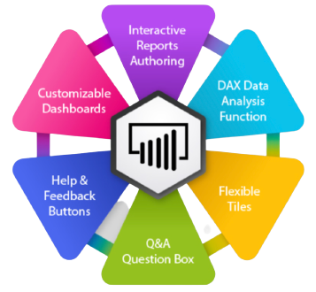

A] Power BI Dashboard Features
Interactive Filters: Select by artist, genre, or date range.
Trend Analysis Charts: Line graphs for song rankings over time.
Geographical Insights: Popular artists/songs by region.
Audio Features Comparison: Analyzing song characteristics.
KPI Metrics: Total streams, top 10 artists, top genres.
B] Key Insights from the Dashboard
Top Artists & Songs: Which artists dominate the charts?
Genre Popularity: Most streamed music styles over time.
Seasonal Trends: Which songs peak during different times of the year?
Audio Features & Popularity: How tempo, energy, and danceability affect streams.

Slide 7
Scope of System
Music Industry Analysts: Identify trends and forecast emerging artists.
Spotify Marketing Teams: Design targeted campaigns based on listener data.
Music Producers: Understand song characteristics that influence popularity.
Educational Purpose: Demonstrate Power BI’s impact on real-world data analytics.
Scalability: Can be adapted for other industries like e-commerce and healthcare.

Slide 8

Hardware & Software Requirements
Hardware Requirements:
Processor: AMD Ryzen 5 / Intel Core i5 or higher
RAM: Minimum 8 GB (16 GB recommended)
Storage: 256 GB SSD or higher
Display: HD (1920x1080) resolution
Software Requirements:
OS: Windows 10 & above
Tools: Power BI, MS Excel, SQL Server
Web Browsers: Chrome, Firefox, Edge

Slide 9

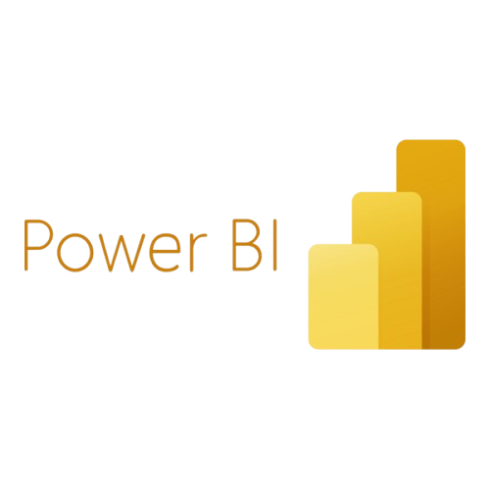


Dataset & Data Sources
Dataset: Spotify Top 200 Songs (updated weekly)
Data source : Kaggle
Key Attributes:
Track Name, Artist, Genre, Streams, Release Date
Audio Features (Danceability, Energy, Tempo, Loudness, Valence, etc.)
Tools Used:
Power BI (for data visualization)
Python (for data cleaning and preparation)
SQL (for data querying and management)

Slide 10
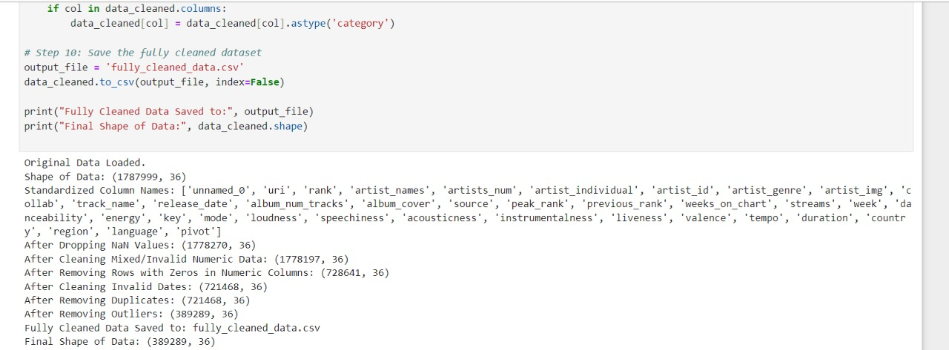
Data Processing & Cleaning
Steps Taken:
Removing duplicates & missing values
Formatting date & numerical data
Standardizing genre and artist names
Calculating new metrics like average streams per artist

Slide 11
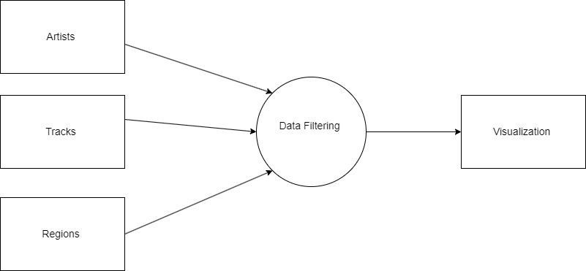
Data Flow Diagram

Slide 12
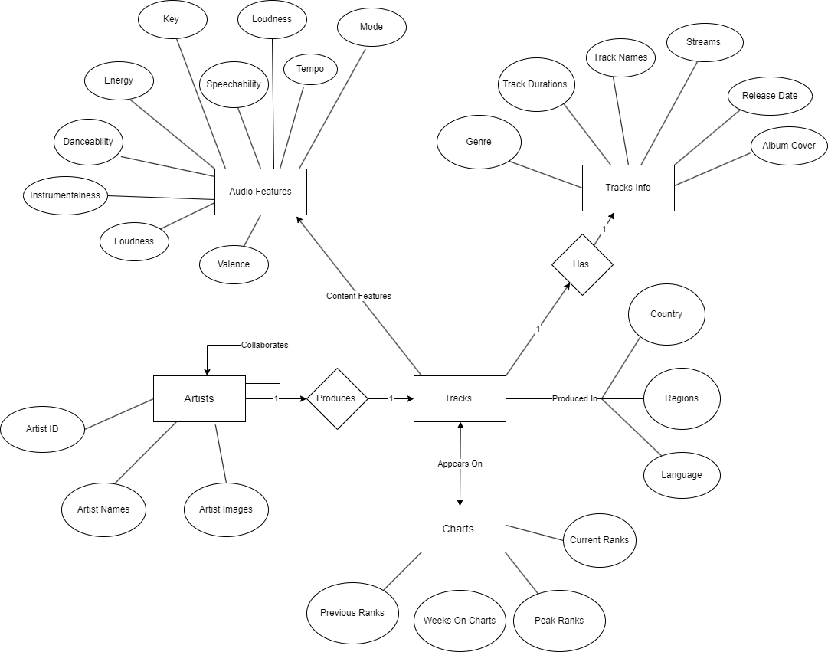
E-R Diagram

Slide 13
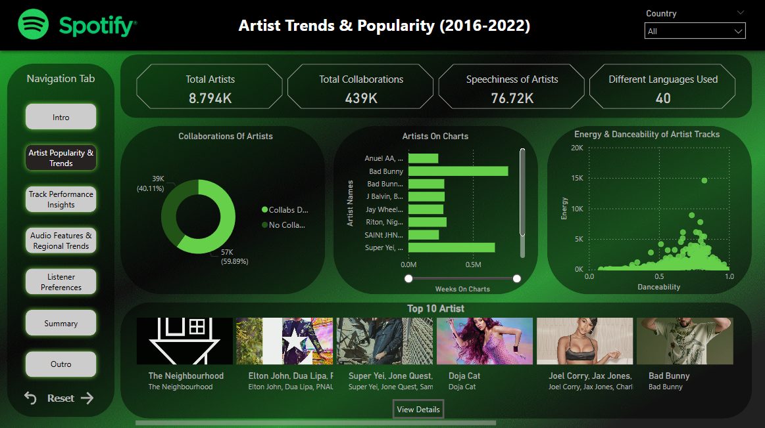

Slide 14
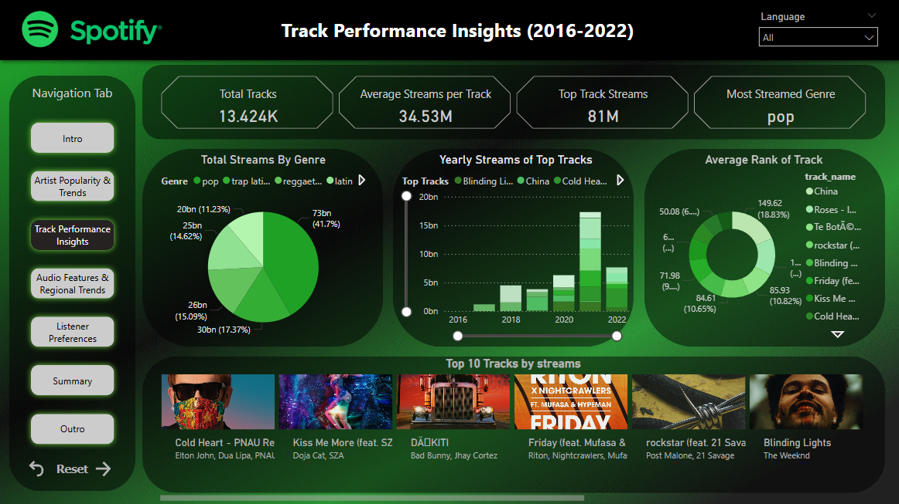

Slide 15
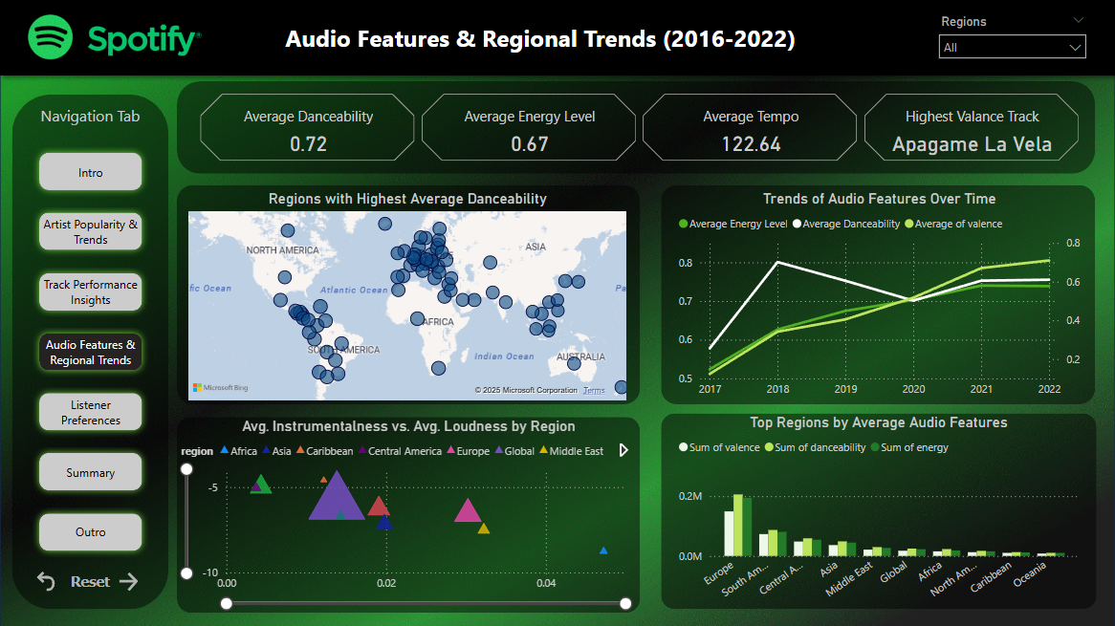

Slide 16
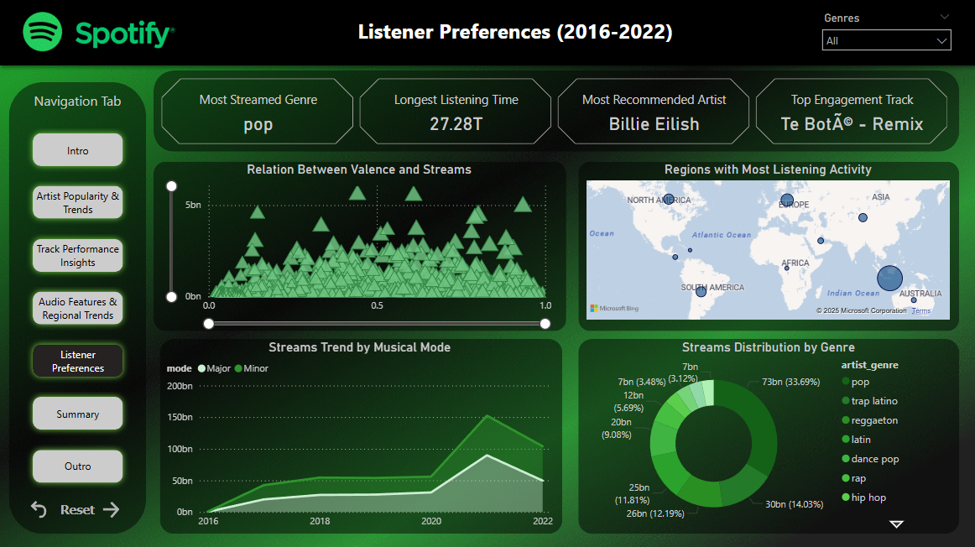

Slide 17
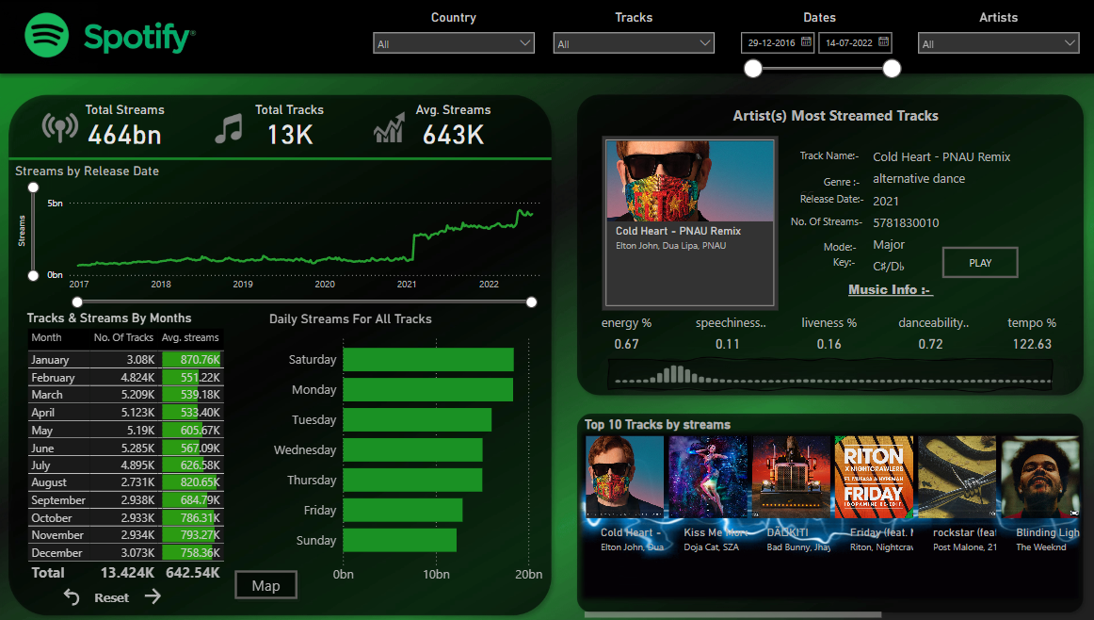

Slide 18


Slide 19

Conclusion
This project demonstrates how Power BI transforms raw data into actionable insights.
Provides music industry stakeholders with meaningful data visualization.
Highlights data-driven decision-making in the entertainment industry.

Slide 20
Bibliography
• Microsoft Power BI Documentation
Microsoft. (n.d.). Power BI Documentation. Retrieved from https://docs.microsoft.com/en-us/power-bi/
• Spotify for Developers
Spotify. (n.d.). Spotify Web API Reference. Retrieved from https://developer.spotify.com/documentation/web-api/
• DAX Guide
SQLBI. (n.d.). DAX Guide. Retrieved from https://dax.guide/
• Data Science for Business
Provost, F., & Fawcett, T. (2013). Data Science for Business: What You Need to Know about Data Mining and Data-Analytic Thinking. O'Reilly Media.
• Power Query Documentation
Microsoft. (n.d.). Power Query Documentation. Retrieved from https://docs.microsoft.com/en-us/power-query/

Slide 21
Web References
Spotify Dashboard using Power BI – Analyzes the most streamed songs using Power BI. GitHub Link
Power BI Project Tutorial | Spotify Dashboard – Step-by-step tutorial for creating a Spotify dashboard. YouTube Link
DIY Spotify Wrapped With Power BI – Analyzing personal Spotify streaming data with Power BI. Blog Link
Power BI and Spotify - A Match Made in Heaven – Visualizing Spotify streaming behavior using Power BI. Community Link

